Slide 1
DevOps Traning
GIT: Merge vs Rebase
your text

Slide 2
GIT: Merge vs Rebase
What is GIT rebase?
What is GIT merge?
The first thing to understand about git rebase is that it solves the same problem as git merge. Both of these commands are designed to integrate changes from one branch into another branch—they just do it in very different ways.

Slide 3
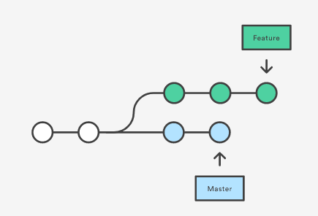
GIT: Merge vs Rebase
Problem Analysis:
You created the new feature Branch and some one else updated the master with some changes.

Slide 4
GIT: Merge
GIT Merge:
To incoporate the changes:
git checkout feature_branch
git merge master

Slide 5
GIT: Merge
GIT Merge:
This creates a new “merge commit” in the feature branch that ties together the histories of both branches, giving you a branch structure that looks like this -

Slide 6
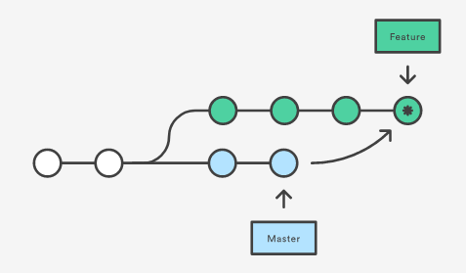
GIT: Merge
GIT Merge:

Slide 7
GIT: Merge
How this will impact:
In this Case feature branch will have an extraneous merge commit every time you need to incorporate upstream changes. If master is very active, this can pollute your feature branch’s history. It can make it hard for other developers to understand the history of the project.

Slide 8
GIT: Rebase
GIT Rebase :
As an alternative to merging, you can rebase the feature branch onto master branch.
git checkout feature_branch
git rebase master

Slide 9
GIT: Rebase
GIT Rebase :
This moves the entire feature branch to begin on the tip of the master branch, effectively incorporating all of the new commits in master. But, instead of using a merge commit, rebasing re-writes the project history by creating brand new commits for each commit in the original branch.

Slide 10

GIT: Rebase
GIT Rebase :

Slide 11
GIT: Rebase
Benefit of GIT Rebase :
You get a much cleaner project history.
It eliminates the unnecessary merge commits required by git merge.
Rebasing also results in a perfectly linear project history.

Slide 12

DevOps Training
Thank You

